Slide 1
CLARK UNIVERSITY
2020 SENIOR THESIS EXHIBITION
FROM CLASSROOM TO QUARANTINE
Emma Carleton, Keren Cohen, Lillian Favreau, Madelaine Hamilton, Galen McDonald, Xuemeng Zhang
Professor Elli Crocker

Slide 2
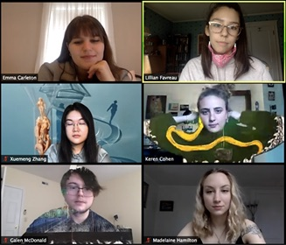

Slide 3
Portrait, Place, and Pattern
Studio Art Senior Thesis
Spring 2020
Emma Carleton

Slide 4
When looking back on the past, do we remember all the minute things that have sparked a smile? Our memories, like paintings, reminding us of times that have swiftly come and gone. The interwoven relationship between these mundane little moments and the distinct thoughts behind them creates this act of reminiscing; every stroke of paint holds this fleeting feeling. Each work is a portrait, whether it be a person or place, laced together by the ties of my love for them, my memory and emotion.

Slide 5
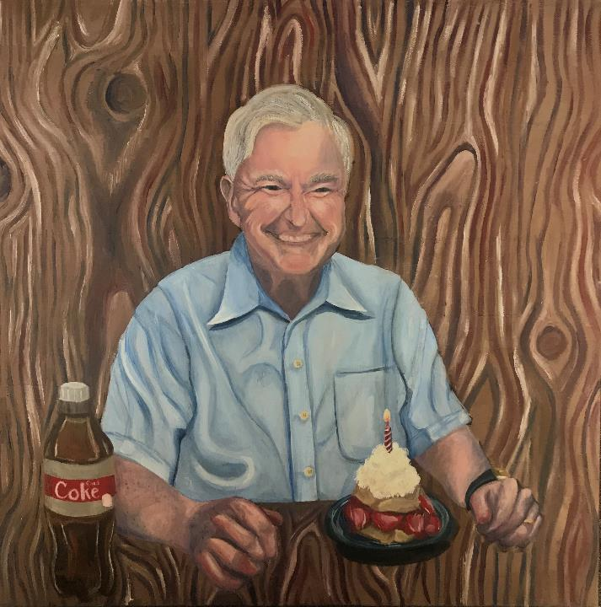
Shortcake, 2020
Water Soluble Oils and Acrylic on Canvas
20”x 20”

Slide 6
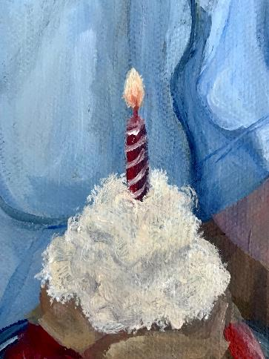
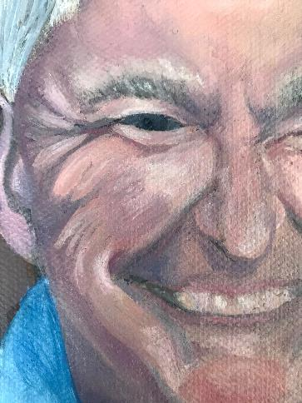
Details of Shortcake, 2020

Slide 7
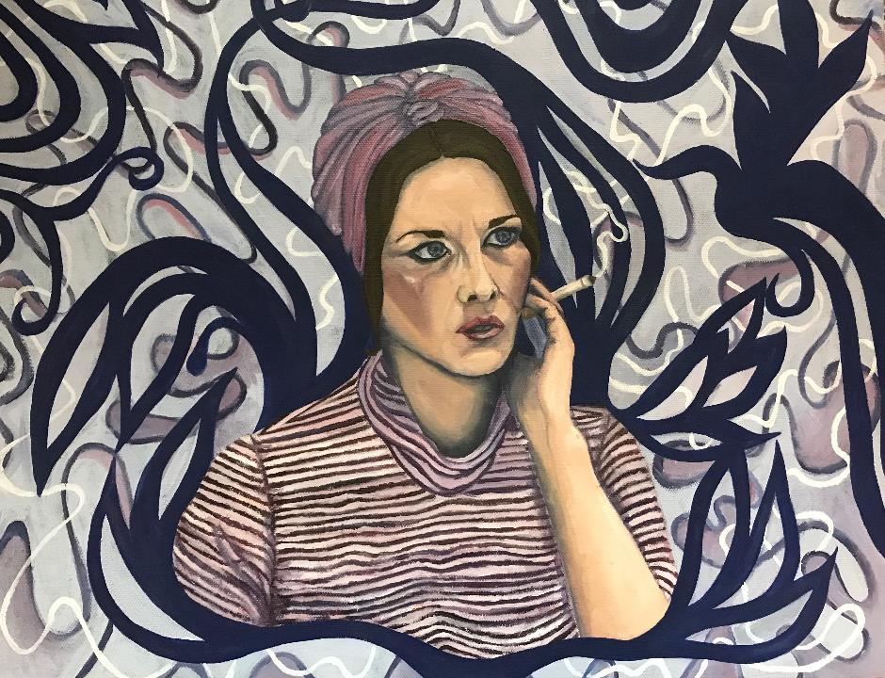
Mother Mary, 2020 Water Soluble Oils on Canvas, 20” x16”

Slide 8
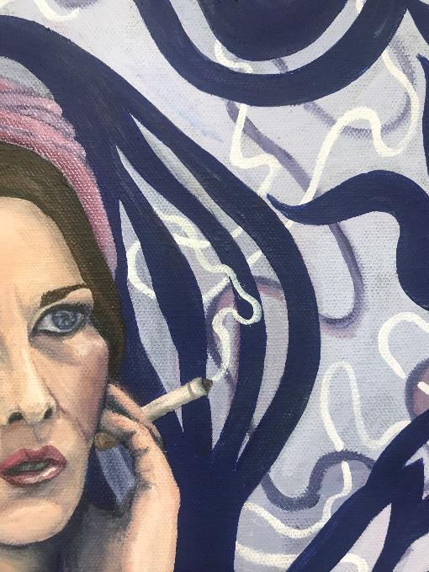
Detail of Mother Mary, 2020

Slide 9
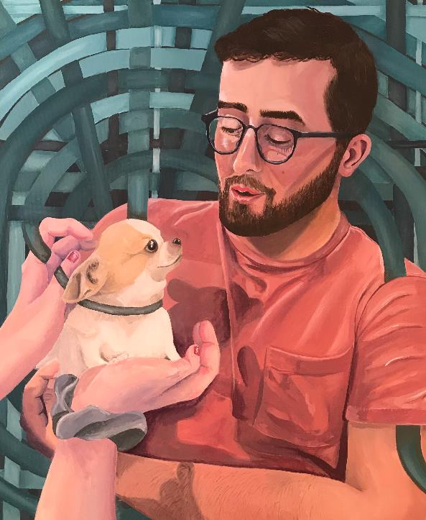
Madonna and Child, 2019
Water Soluble Oils and Acrylic on Canvas
20” x 24”

Slide 10
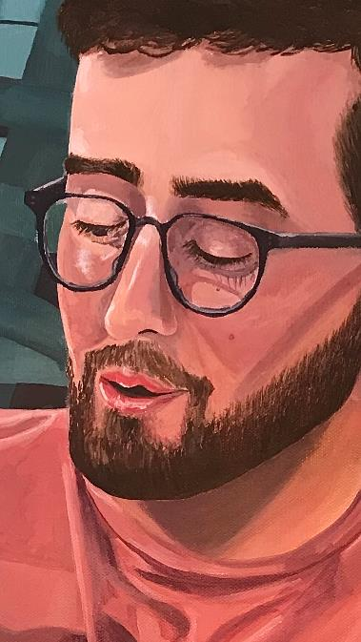
Detail of Madonna and Child, 2019

Slide 11
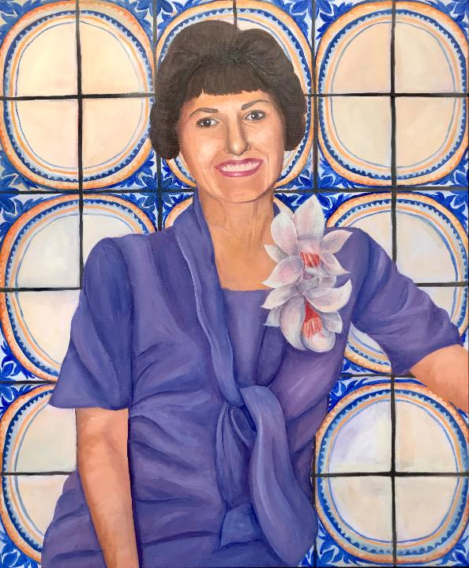
Becoming a Matriarch, 2020
Water Soluble Oils and Acrylic on Canvas
20”x 24”

Slide 12
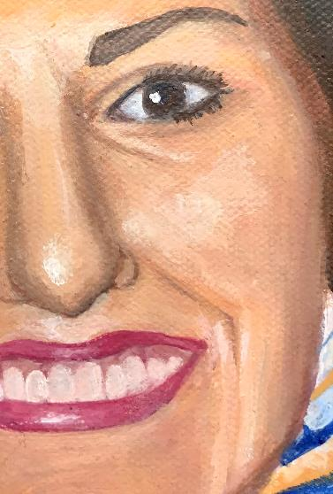
Detail of Becoming a Matriarch, 2020

Slide 13
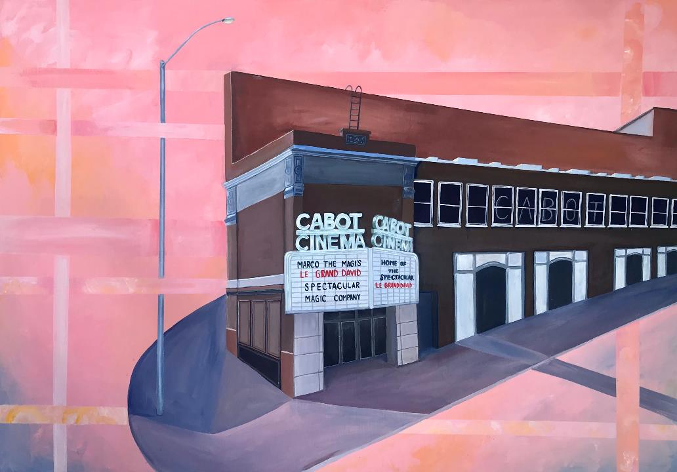
The Cabot: Home of Le Grand David, 2020
Flashe Vinyl Color and Acrylic Paint on repurposed Ikea framed wall print.
55 ¼” x 39 ¼”

Slide 14
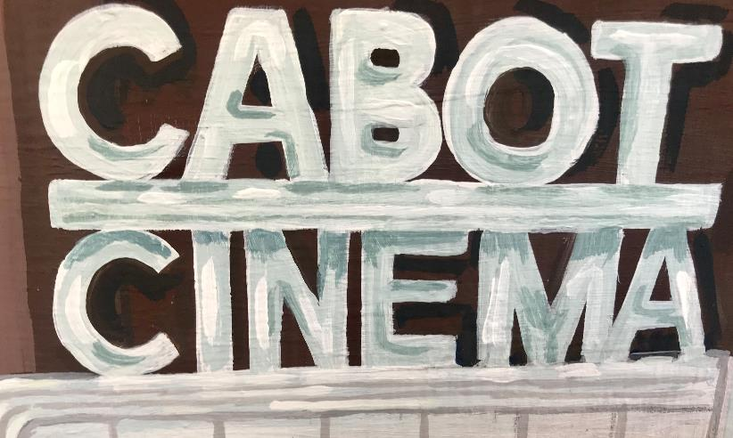
Detail of The Cabot: Home of Le Grand David, 2020

Slide 15
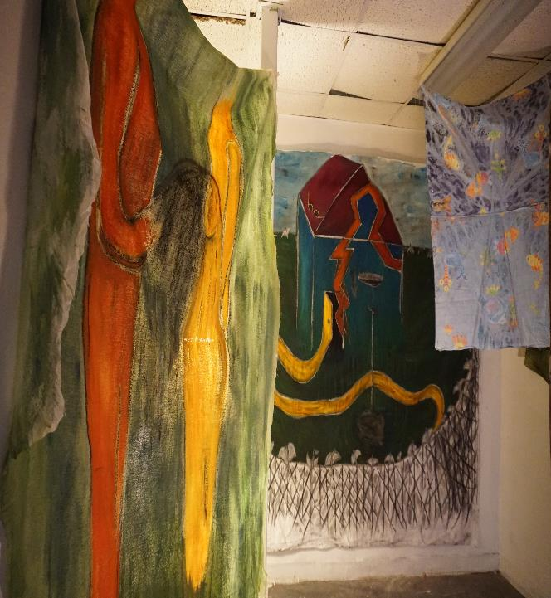
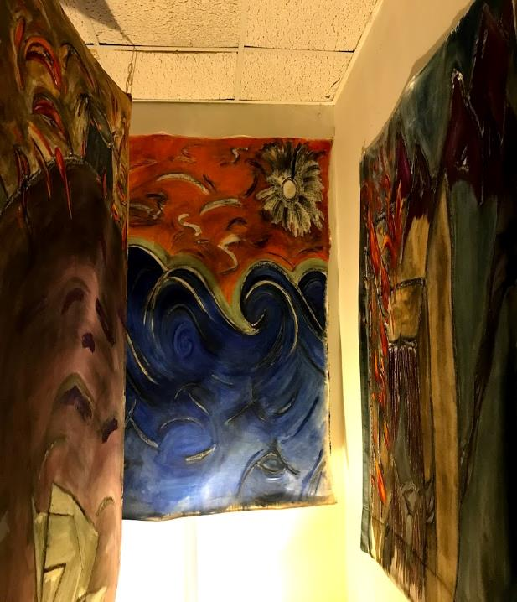
Studio Art Senior Thesis
The Dream Collection
Keren Cohen

Slide 16
Artist Statement
Bits and pieces of hazy imagery
Constantly slipping away by the second,
Reaching for the journal on my nightstand.
Scribbling, writing, drawing
The unconscious experience.
Dreams unlock layers into another dimension of the soul
When nothing makes sense,
The innermost feelings, fantasies, and dilemmas are exposed.
Overwhelmed by the meaning of these stories and adventures
I expressively paint my jumbled emotions
Trying desperately to get back in to reveal my truths
They become all consuming,
Swallowing.

Slide 17
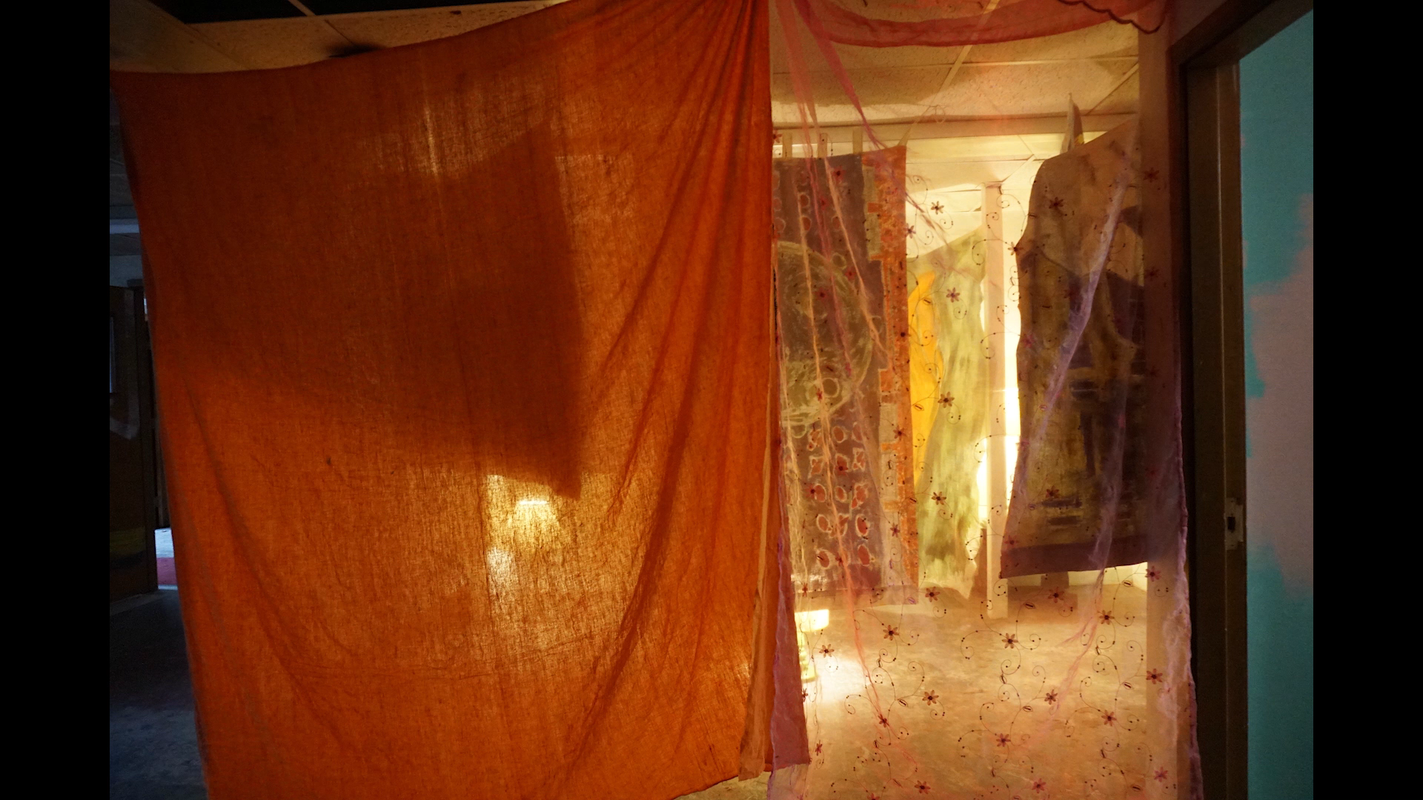
STOP MOTION VIDEO OF INSTALLATION

Slide 18
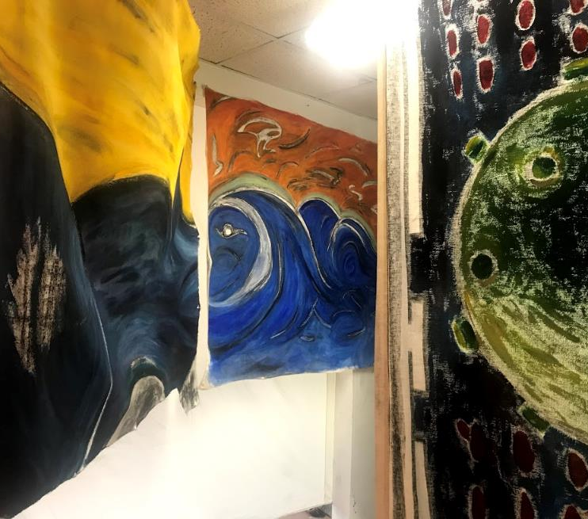
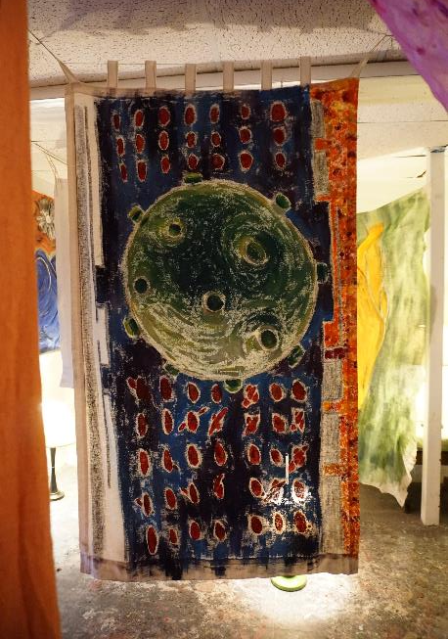

Slide 19
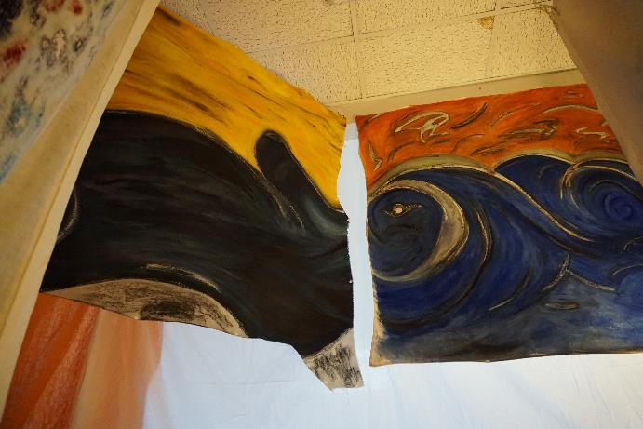
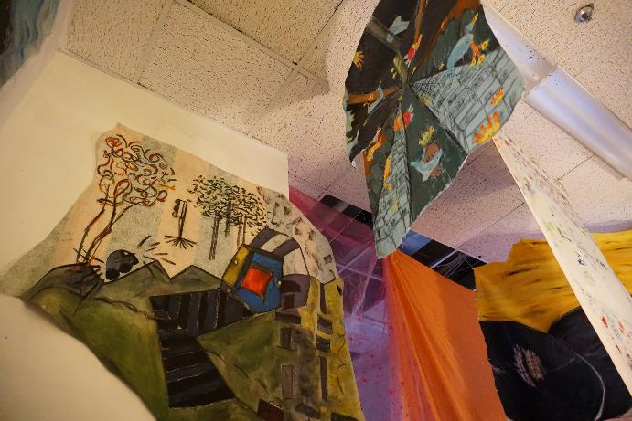

Slide 20
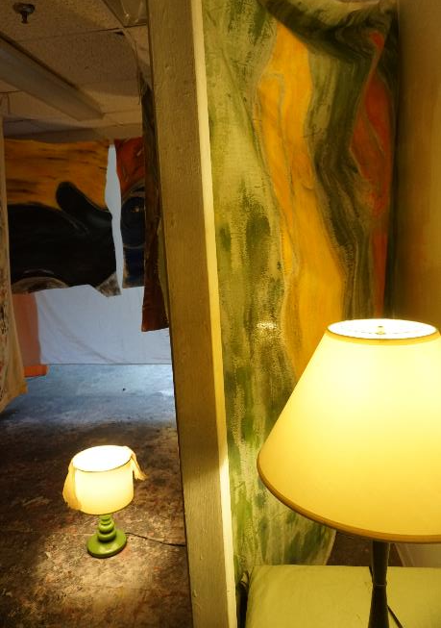
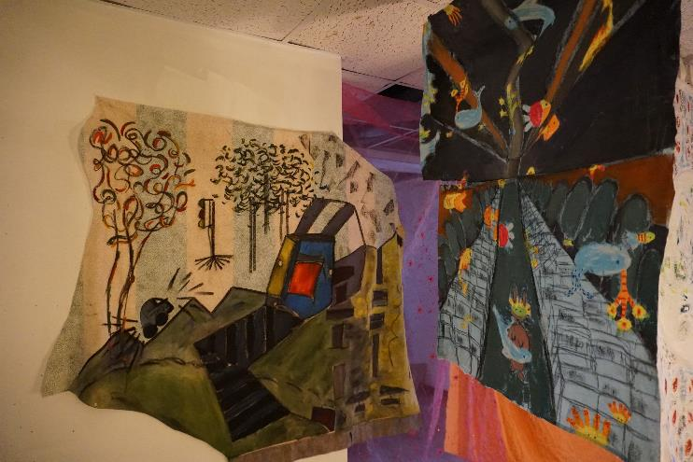

Slide 21
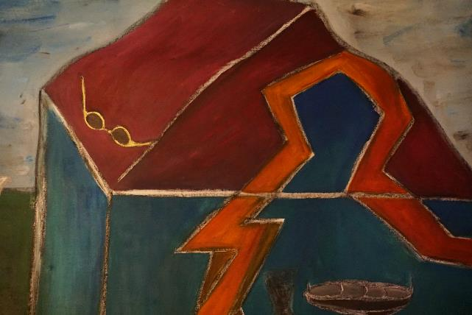


Slide 22

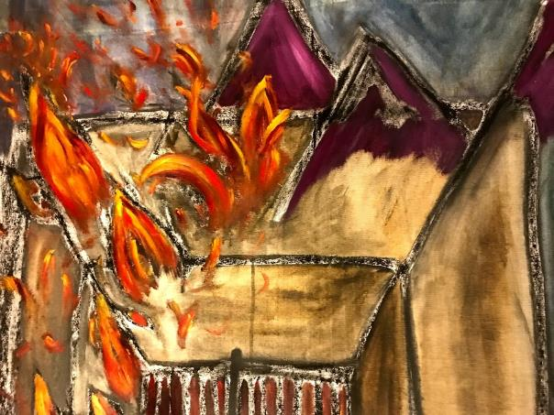

Slide 23
Wallpaper Portraiture
Spring 2020
Lillian Favreau

Slide 24
Artist Statement
For this series, I was considering the history of portraiture and exploring connections between identity and personhood and the associations between family and home. From the framed family photo to the design of the rocking chair and painted china plates, what elements define domestic spaces? In my home, it was the wallpaper. The bright colors, the swirl of the floral patterning, I grew up in a house filled with art that I hadn’t considered. In honor of this, I render portraits of my family members as wallpaper swatches, which I achieved through the creation and use of repetitive tile patterning.
I created two compositions centered around my sister and my father and the ways that they exist in my memory. After completing the two pieces, I became interested in expanding this connection between memory and wallpaper. I wanted to further explore its impersonal quality and the associations and expectations of its decorative role in the home. For my third and fourth pieces, I wanted to create an all-encompassing pattern that references my family’s shared history. At the same time, I was also considering the styles and design of wallpaper throughout Western history. As a reference to family history and the origins of wallpaper itself, my last pieces are rendered in the style of “toile de Jouy”, a popular patterning for textiles that originated in France during the 18th century.

Slide 25
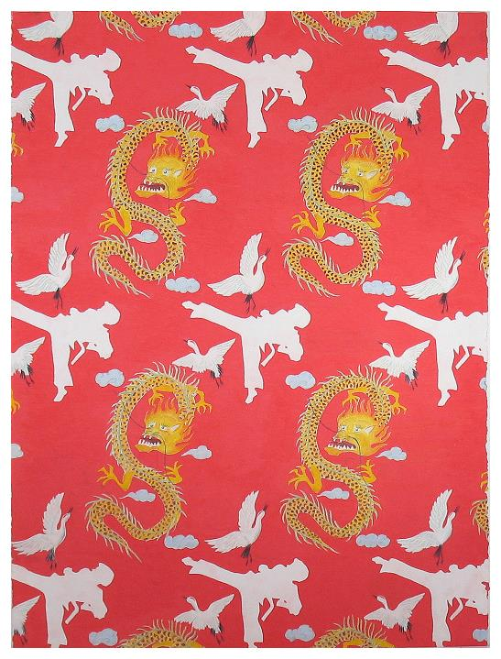
Papa, colored pencil on paper, 30x22 inches.

Slide 26
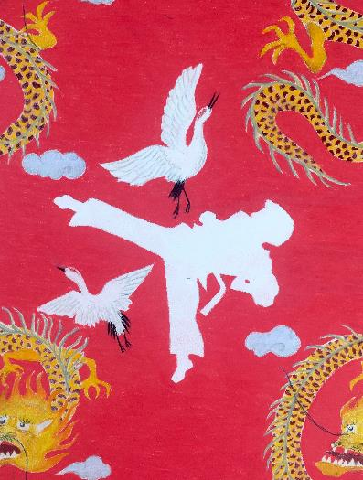
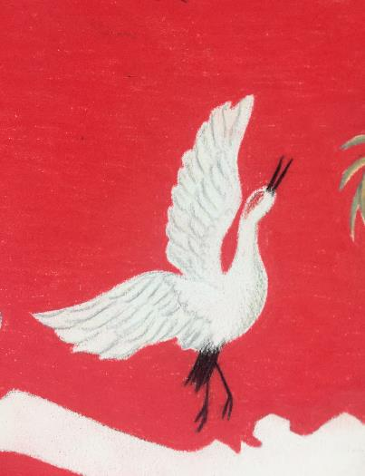
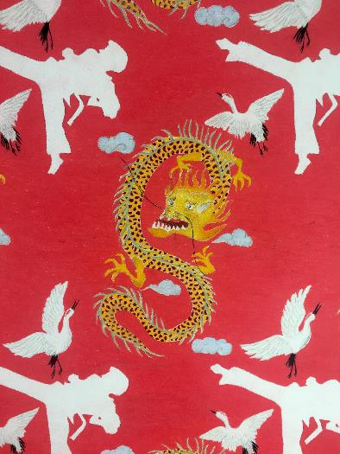

Slide 27
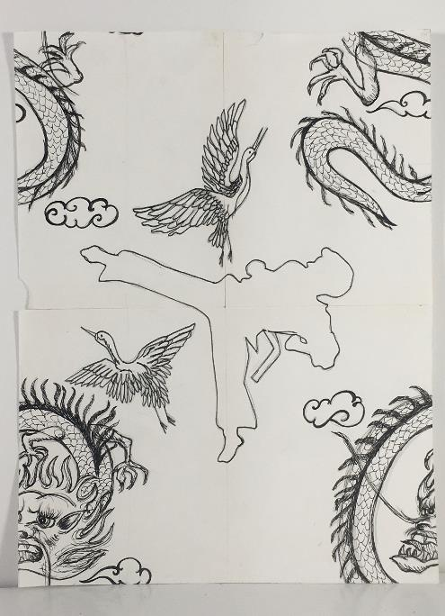
Papa pattern tile

Slide 28
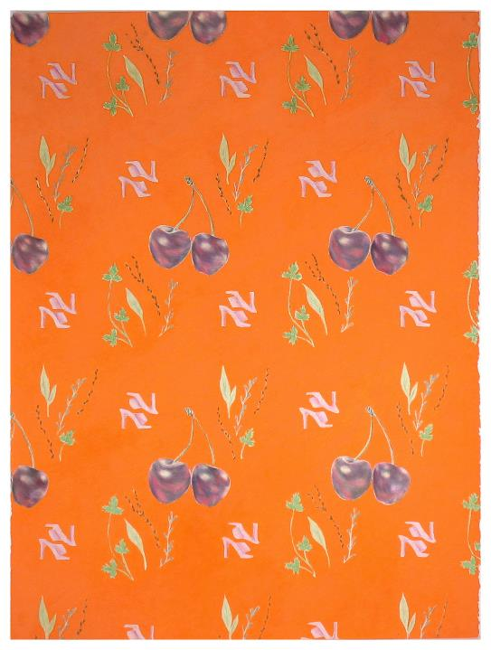
Eva, colored pencil on paper, 30x22 inches.

Slide 29
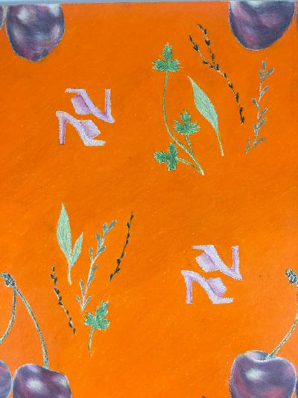
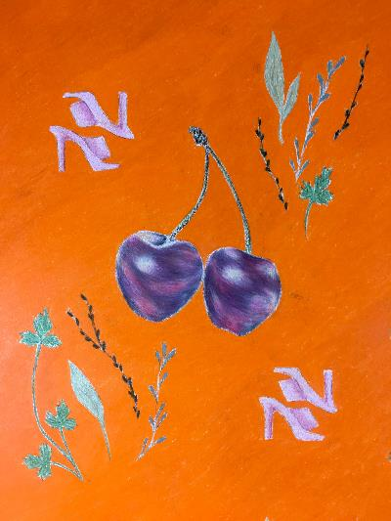
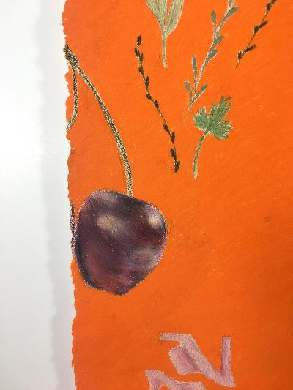

Slide 30
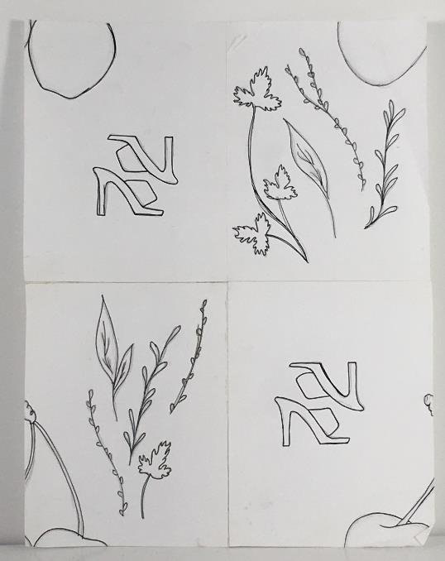
Eva pattern tile

Slide 31
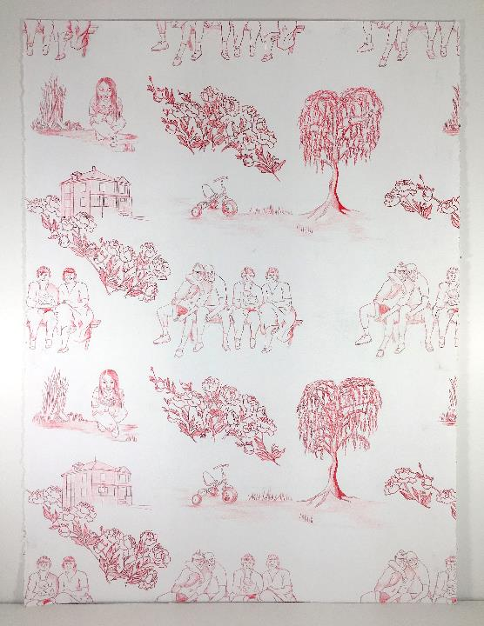
Toile at 22 (red), colored pencil on paper, 30x22 inches.

Slide 32
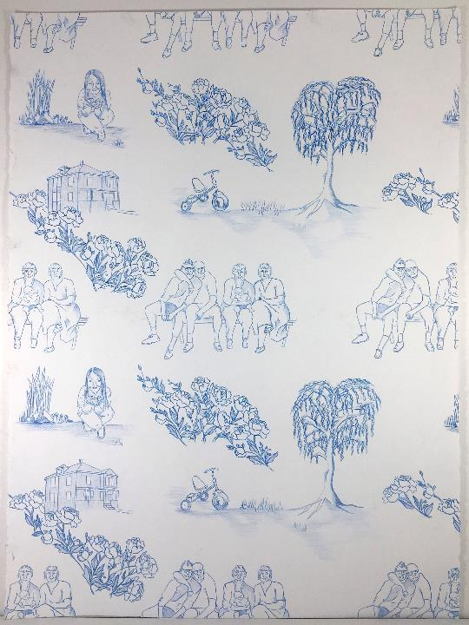
Toile at 22 (blue), colored pencil on paper, 30x22 inches.

Slide 33
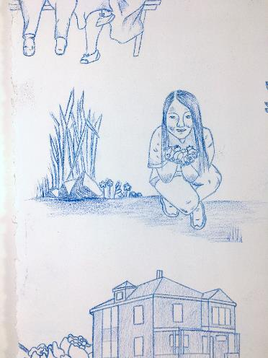
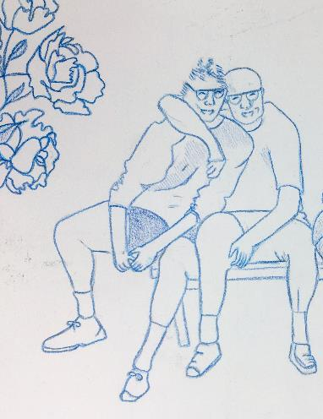
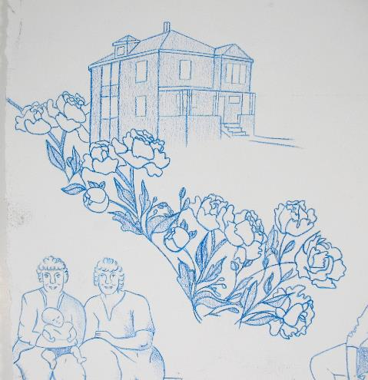

Slide 34
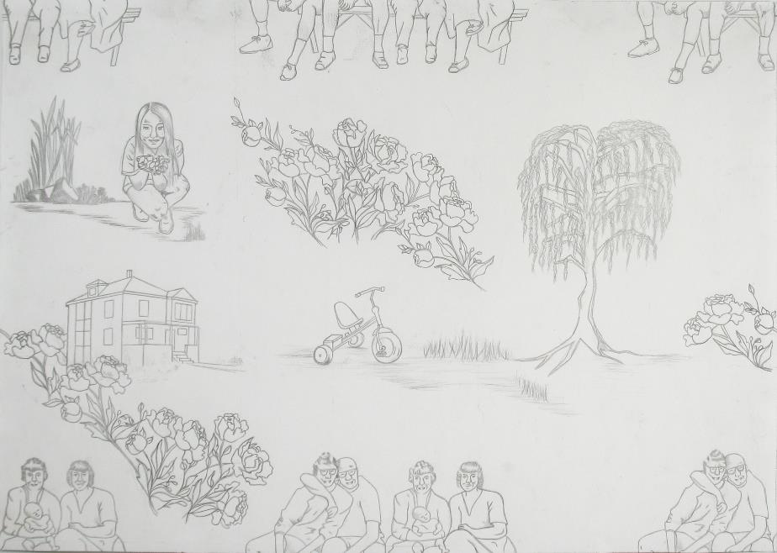
Toile at 22 pattern tile

Slide 35
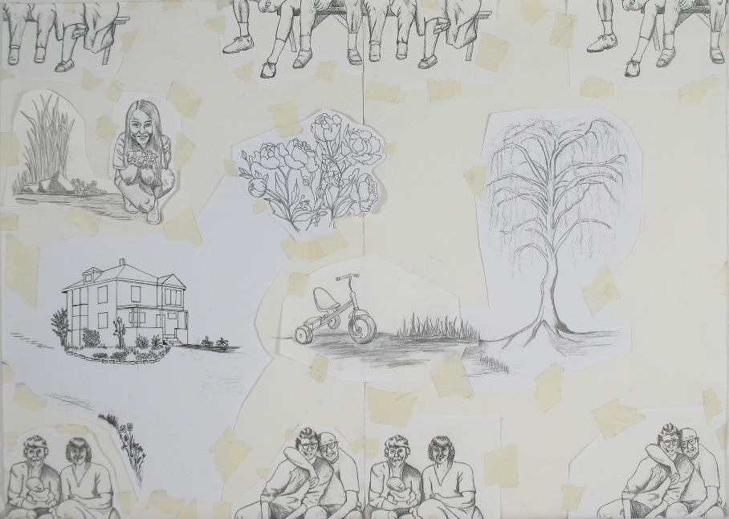
Toile at 22 pattern tile

Slide 36
Ray of Light
Madelaine Hamilton
Spring 2020

Slide 37
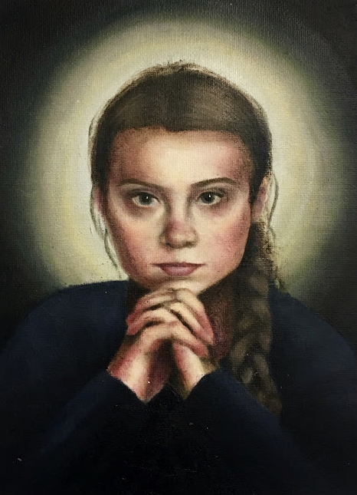
Greta, oil on canvas paper, 9” x 12”

Slide 38
Ray of Light
Light doesn’t need a medium through which to travel no matter the source or the direction from where it shines. The speed of light is a universal physical constant.

Slide 39
Artist Statement
The effects of visible light waves can be felt even in those who are blind. The speed of light, 299,792,458 meters per second, is the same no matter where you are in the universe. Whether you are on Earth or in the empty vacuum of outer space, the speed of light is a universal physical constant.
The presence of light affects our brain activity and the physical world in numerous ways unrelated to sight.

Slide 40
The sun in our solar system provides energy used by all living things. The stars reflect light waves that have traveled billions of light-years to illuminate our night sky. For hundreds of generations, the glowing solid particles in flames have given us warmth and shelter.
The human body itself emits a characteristic spectrum of light waves, called black-body radiation.
We are children of light.
Light is an indispensable source of meaning for our human capacity for justice, empathy, and compassion. During a time of inexorable darkness and uncertainty, I explore this idea of light and our common humanity through portraits of my classmates and other individuals.

Slide 41
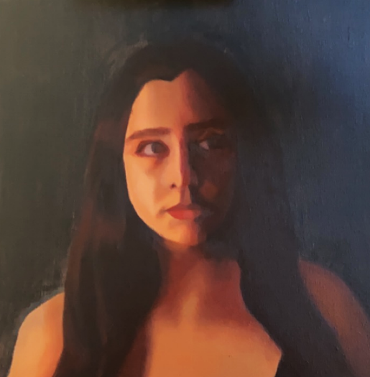
Lillian, oil on canvas, 14” x 14”

Slide 42
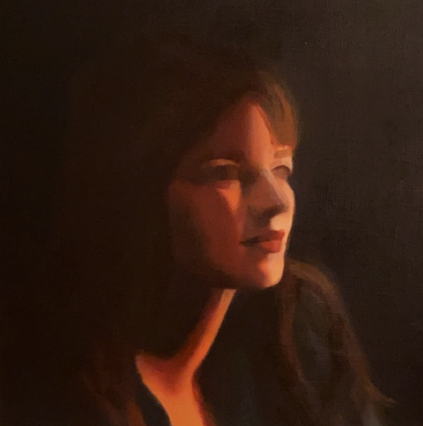
Emma, oil on canvas, 14” x 14”

Slide 43
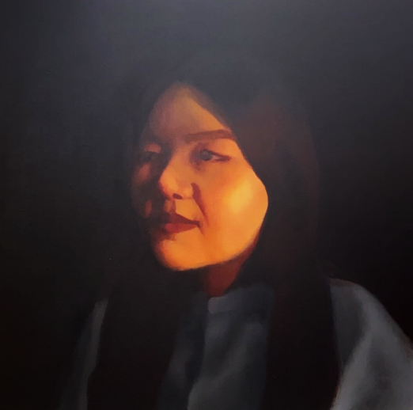
Xuemeng, oil on canvas, 14” x 14”

Slide 44
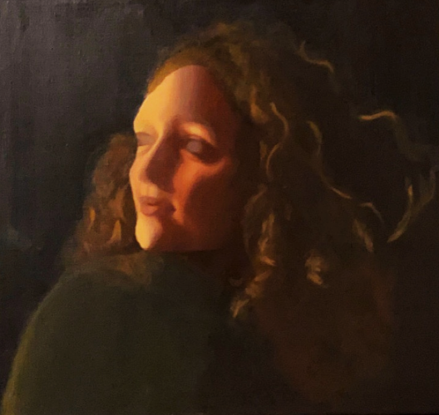
Karen, oil on canvas, 14” x 14”

Slide 45
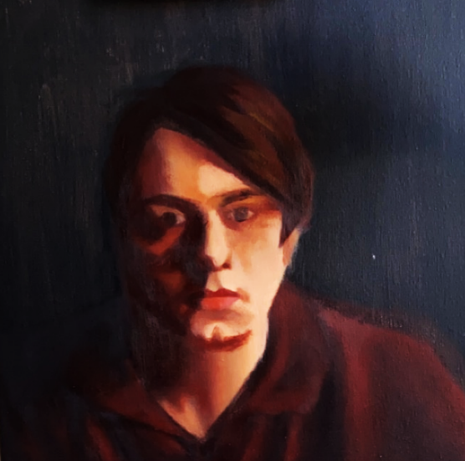
Galen, oil on canvas, 14” x 14”

Slide 46
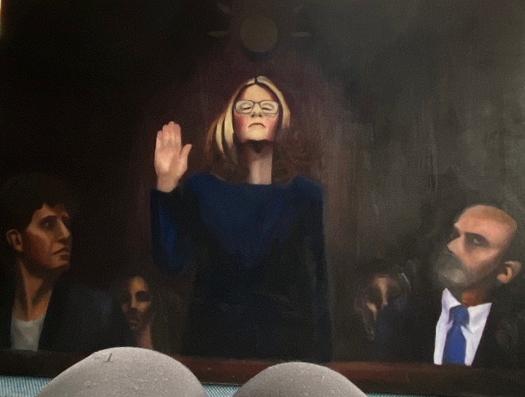
So Help You God, oil on canvas, 36” x 48”

Slide 47
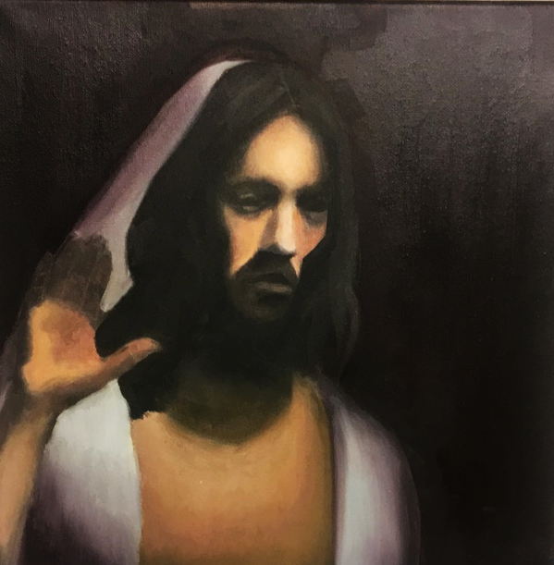
Study of Resurrected Christ, 2020, oil on canvas, 14” x 14”

Slide 48
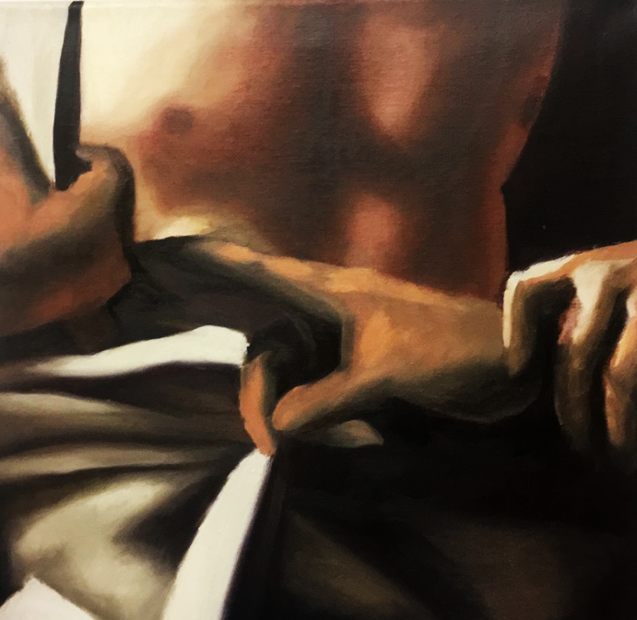
Study of Caravaggio’s Doubting Thomas (ca 1600), oil on canvas, 14” x 14”

Slide 49
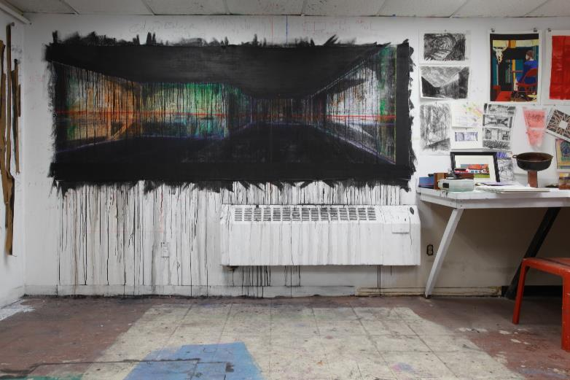
Progress and Problem Solving/A Shift in Perspective and the Gordian Knot
Galen McDonald : Senior Art Thesis 2020

Slide 50
Project Statement
The information age surrounds us. We put our faith in the hands of the digital search engine. Any question you have answered in less than a second. Millions and millions of answers, to every topic we have at a moment's notice. Before my time, my parents spoke of going to the basement of their local library and digging through tapes and microforms to complete their research papers. With the advent of the internet, access to new information has never been so easily accessible; and with that accessibility comes a reliance and trust of these illusionary facts and worlds.
The way we see the world is no longer through long walks and moments of ponderance at leaves and grass. Observing the world has been taken over by drones and data, more capable than us of reaching distant places and capturing wide swaths of land. Knowing where your private domicile is, is no longer private information. The whole world has access to seeing where you live in detailed 3D models. Due to the ever present surveillance of our surroundings and our eagerness to adopt new ways of modeling the Earth we no longer have a moment to ourselves that is not documented by some computer system. Our impressions of our surroundings are being based on the screens and limits of the technology used to display our environment.

Slide 51

Goals for the Course
Work Larger
Experiment with new mediums
Create my own mediums and supplies
Work with what I already have
Develop a process and routine
Create a cohesive body of work
Research past and current artists
Think outside the box

Slide 52

Artist Background
IT Background
Photographer
Painter
DIY Mechanic
Have taken classes in:
Sculpture
Printmaking
Painting, (oil, watercolor, guache, ink, acrylic)
Photography
Drawing
Book making
Ceramics
Graphic design
Geographic Info Sciences
Biology

Slide 53

Progress and Problem Solving, 2019, ~6’x15’

Slide 54



Series 2, 2020

Slide 55

E3, 2020, 16”x30”

Slide 56

E2, 2020, 16”x30”

Slide 57

E1, 2020, 16”x30”

Slide 58

Transition, 2020, 25”x25”

Slide 59



Slide 60



Slide 61

Studio Art Senior Thesis Project:
All of Us
Xuemeng Zhang
Clark University (Class 2020)
Thesis Supervisor: Professor Elli Crocker

Slide 62
Artist Statement
In the first half of 2020, the rapid spread of COVID-19 broke into everyone’s life. When the first case of coronavirus occurred, it seemed so far away. Most could not imagine its impact until it got closer and closer to us physically. Emotionally, it was never far away. As a Chinese national studying abroad in the U.S., I witnessed how the crisis first impacted the lives of my families, friends, and citizens, then became a global crisis where all humans must stand together to fight.
During this difficult time, uncertainty raises fear, crisis reveals inequality, self-interest conceals empathy, and prejudice instigates hatred. As a lens-based artist, I felt obligated to record and lay bare these issues using the language of photography. Through the construction of small scenes and the play of shadow, I document stories of this unusual time and express my deepest feelings as a witness to history. Objects in the photographs are narrators, revealing the stories of us all.

Slide 63

Unreachable
Digital Inkjet Print
19 x 13''
2020

Slide 64

She Dreamed A Dream
Digital Inkjet Print
19 x 13''
2020

Slide 65

Those Above, Those Below
Digital Inkjet Print
19 x 13''
2020

Slide 66

Light Lives, Heavy Gold
Digital Inkjet Print
19 x 13''
2020

Slide 67

Cannibalism
Digital Inkjet Print
19 x 13''
2020

Slide 68

Quarantine
Digital Inkjet Print
19 x 13''
2020

Slide 69

Chance
Digital Inkjet Print
19 x 13''
2020

Slide 70

Help!
Digital Inkjet Print
19 x 13''
2020

Slide 71
https://www.xuemengzhang.com
2020 Xuemeng Zhang All Rights Reserved

